Slide 1
If you are only doing code with agentic AI, you are doing it wrong
By Llewellyn Falco

Slide 2
1. Manage Complexity
2. See Abstractions
3. Create reuseable pieces

Slide 3
A peculiar issue…

Slide 4



Thursday
Approvals.java
Scott
Stefan

Slide 5
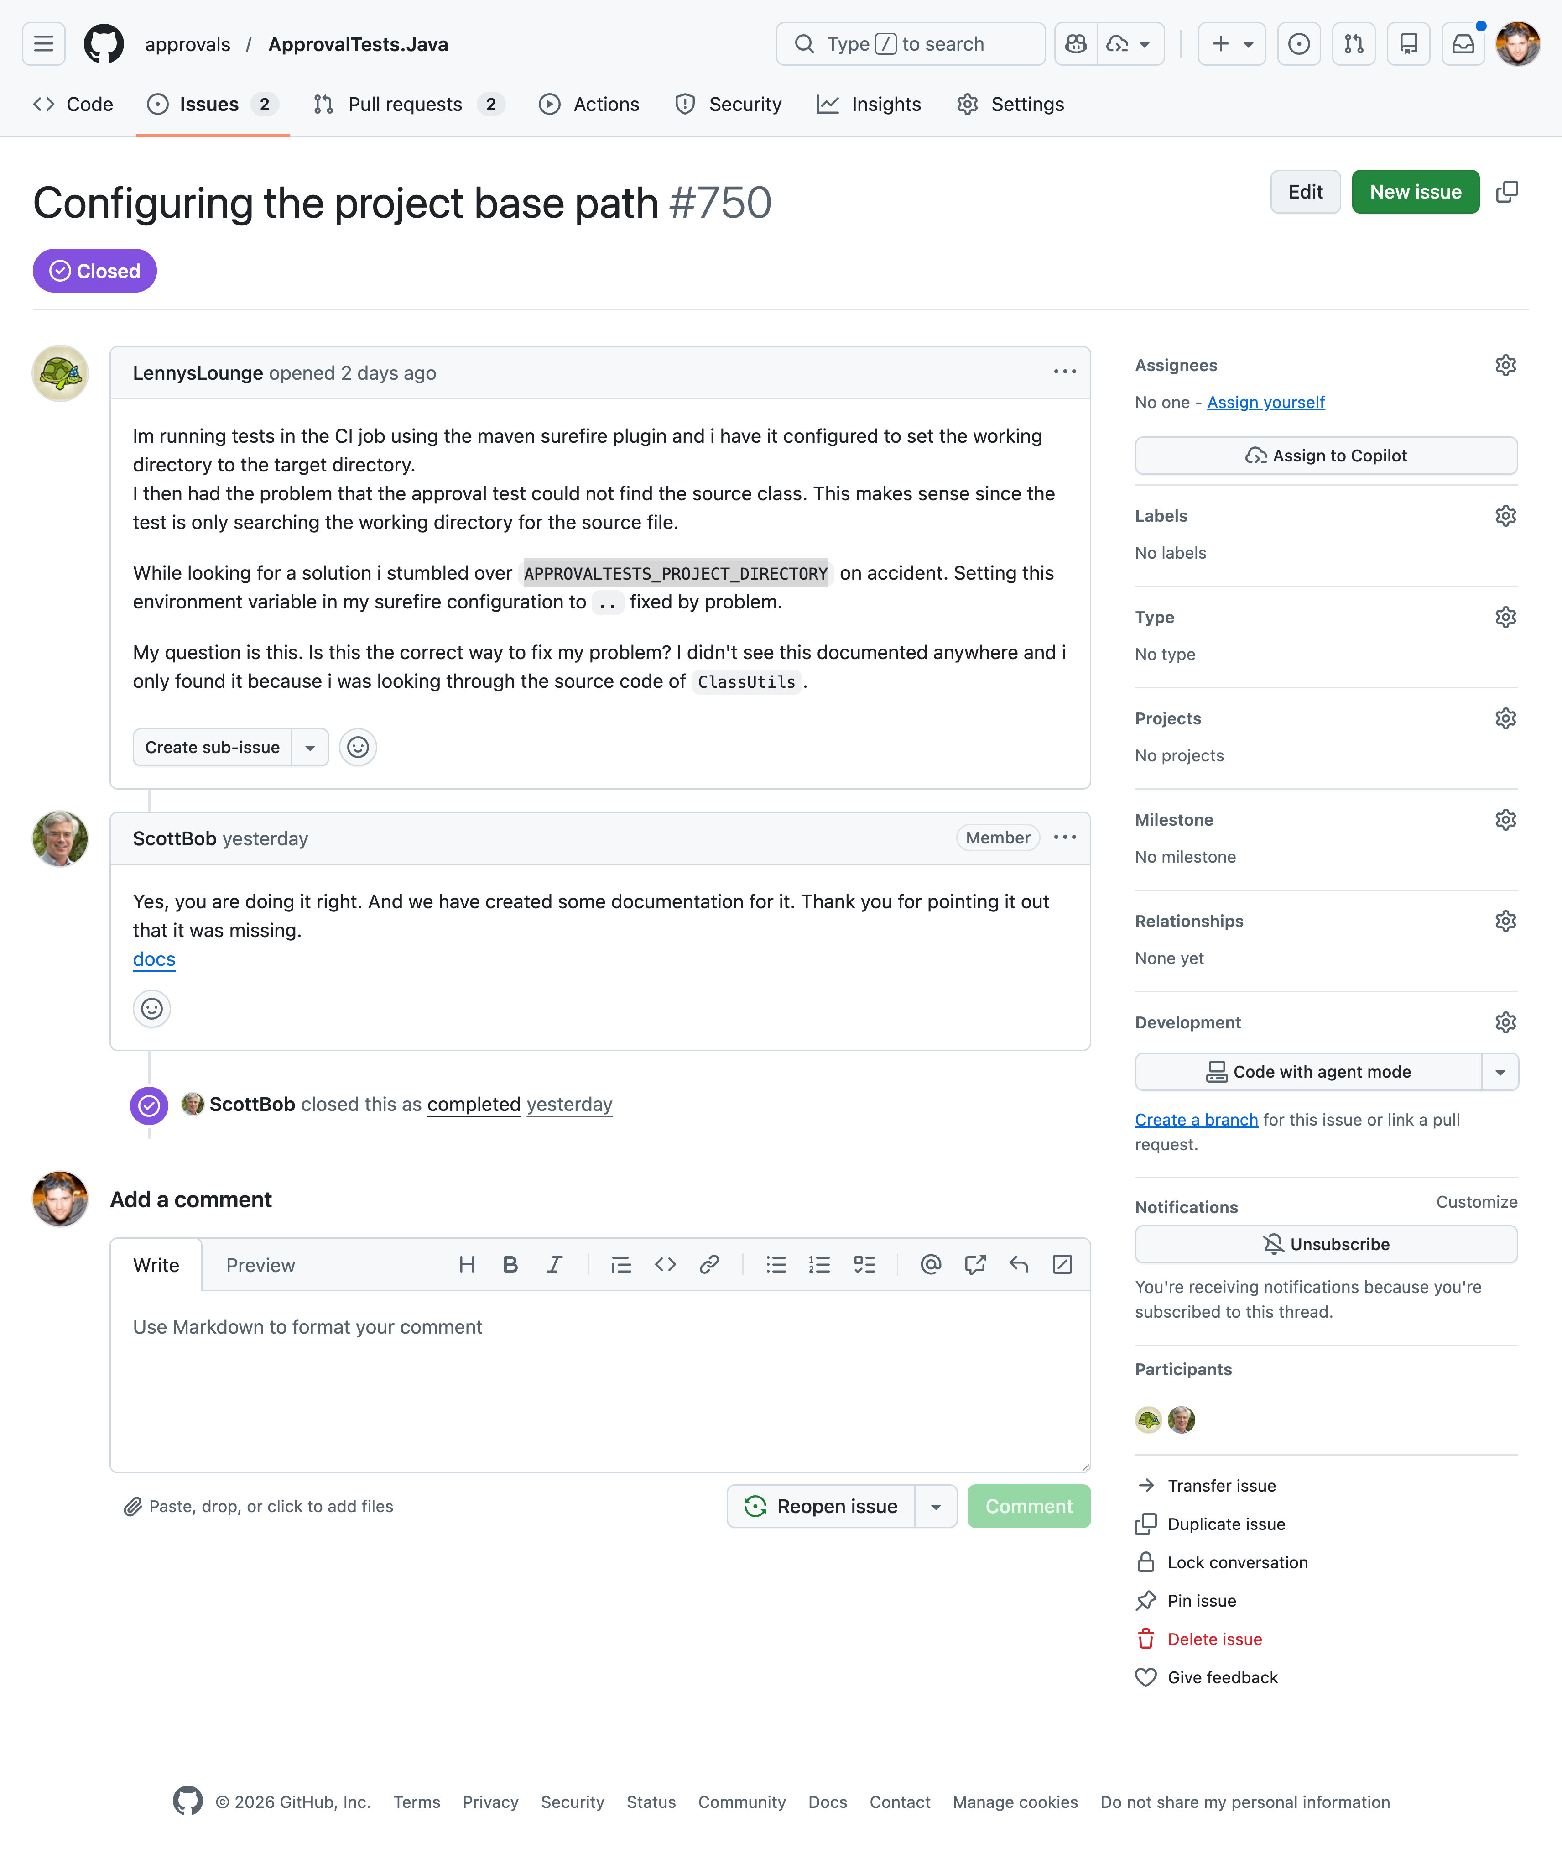

Slide 9
TUTORIALS
HOW-TO GUIDES
EXPLATATION
REFERENCE
*Daniele Procida's theory of documentation

Slide 10
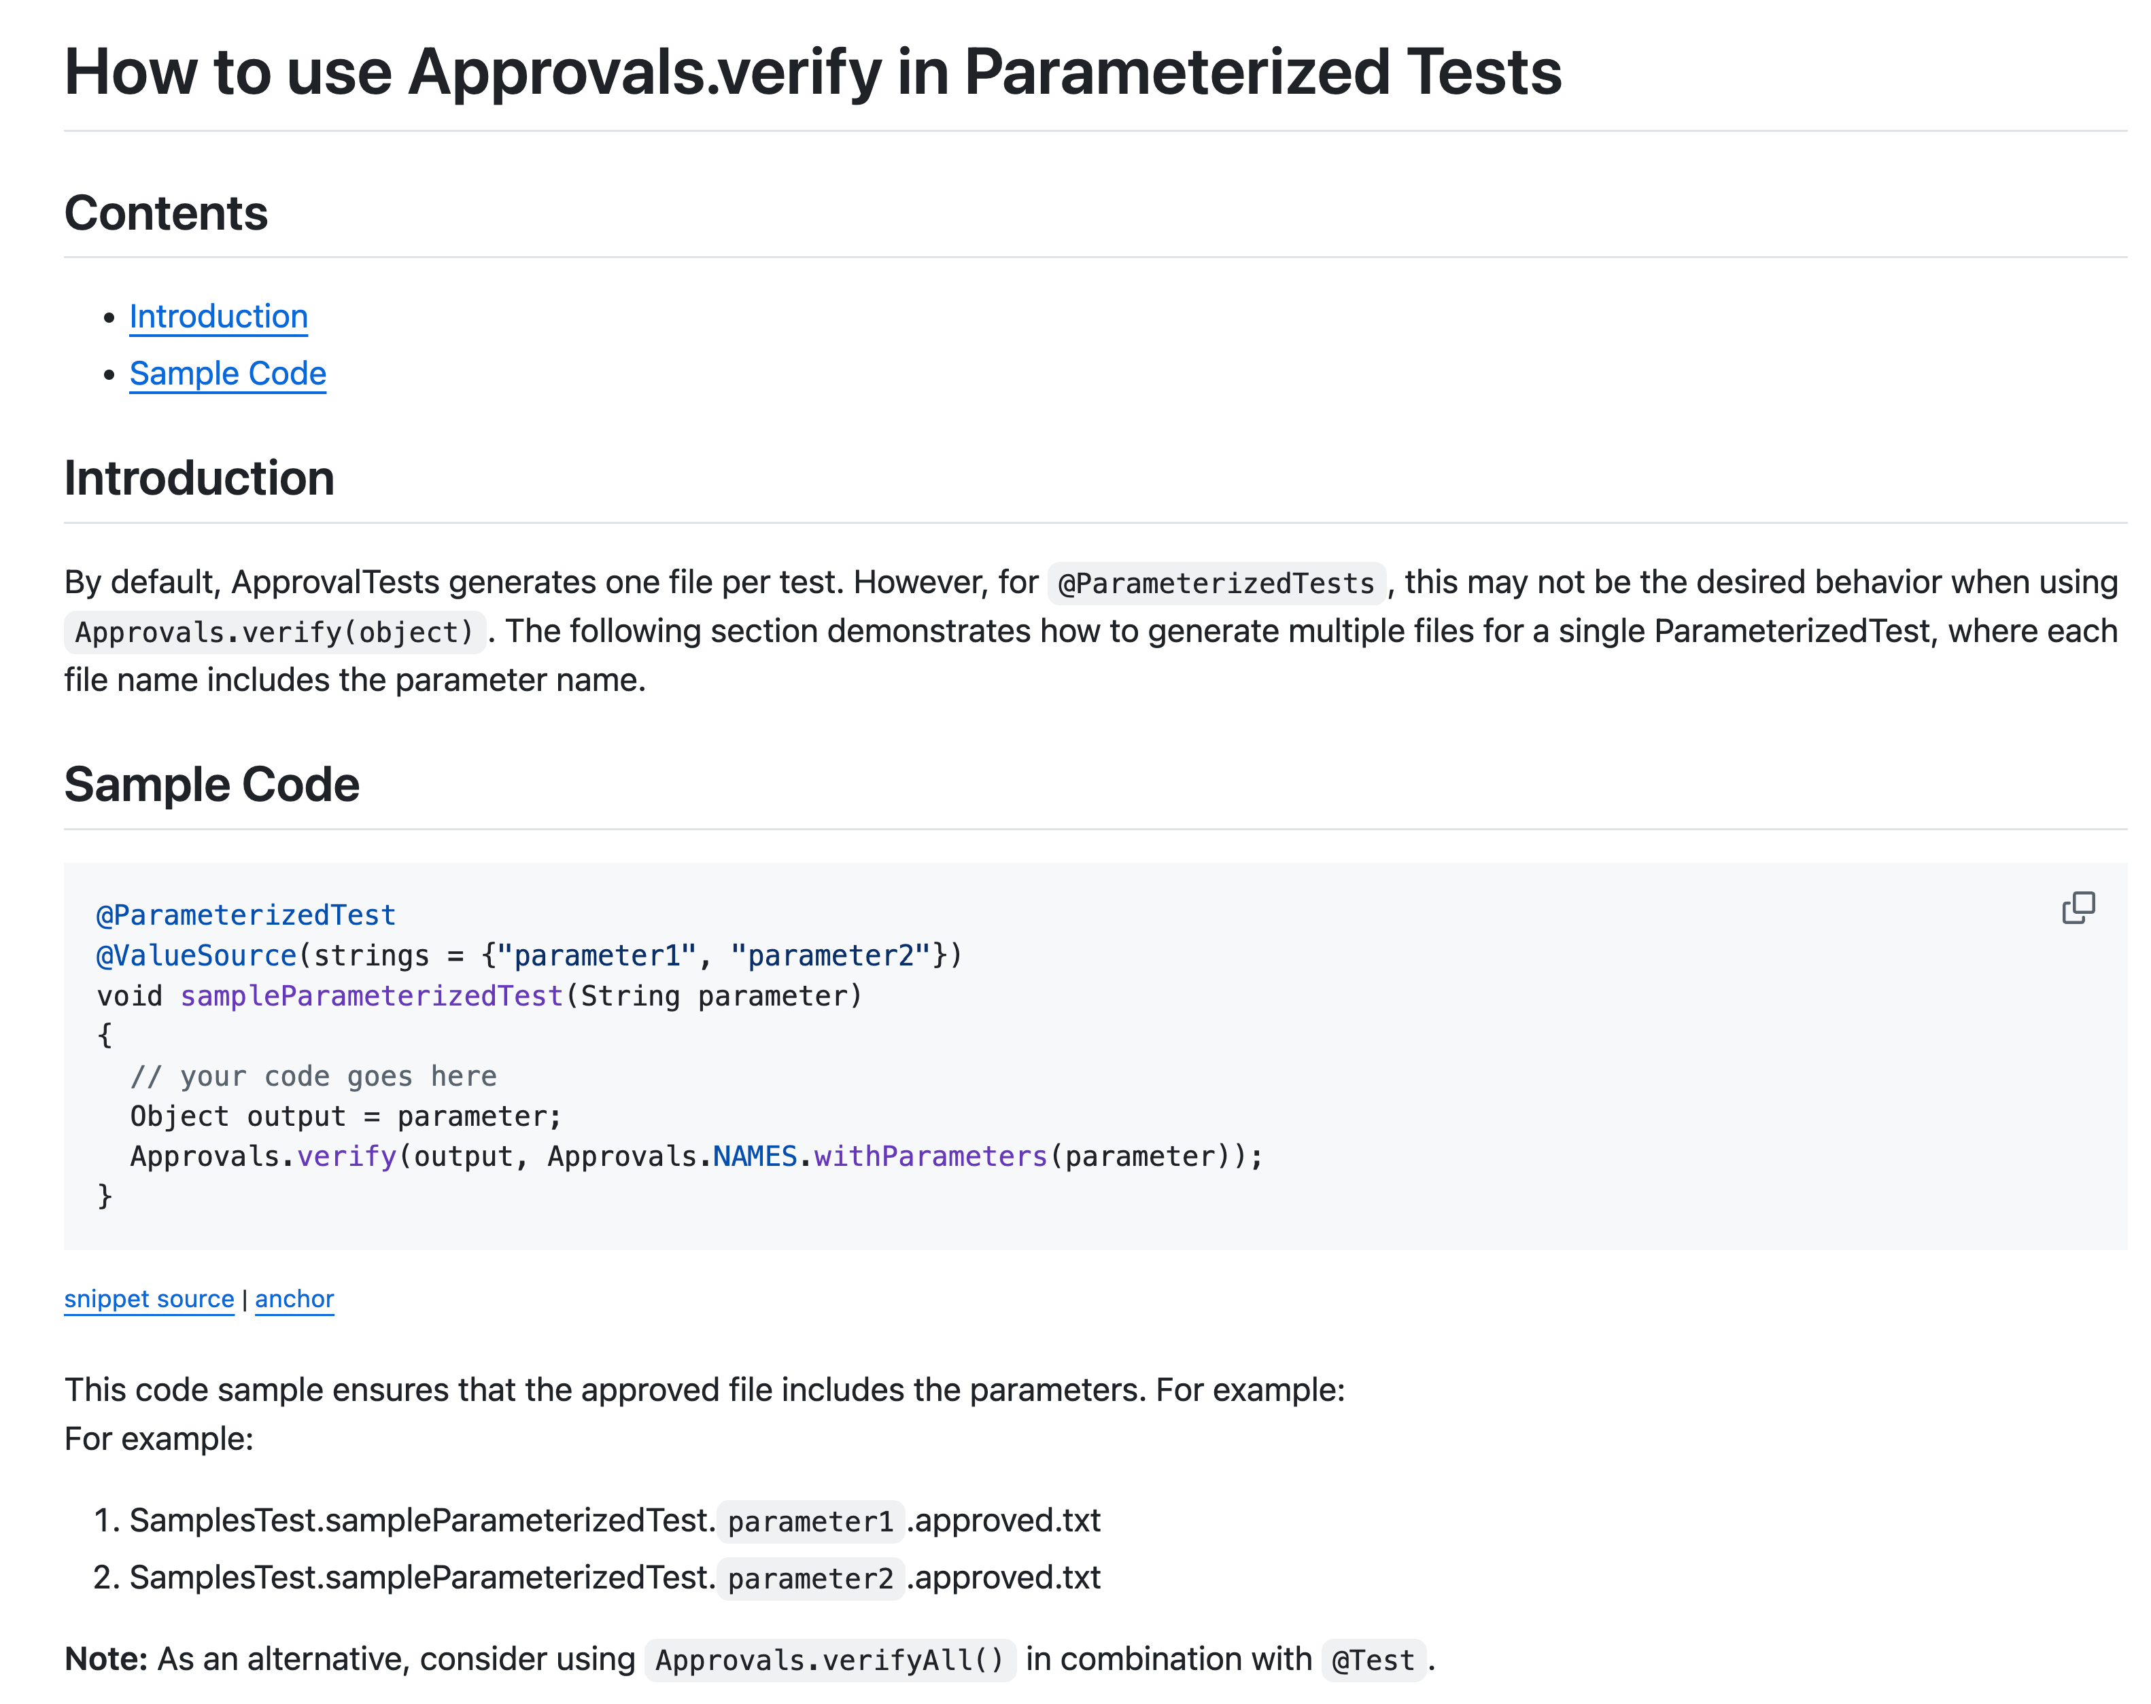

Slide 11
Please read issue 750 & 608 using the github cli. This is the right solution, but we need to make a howto doc. You can see an example here @ParameterizedTest.md

Slide 12
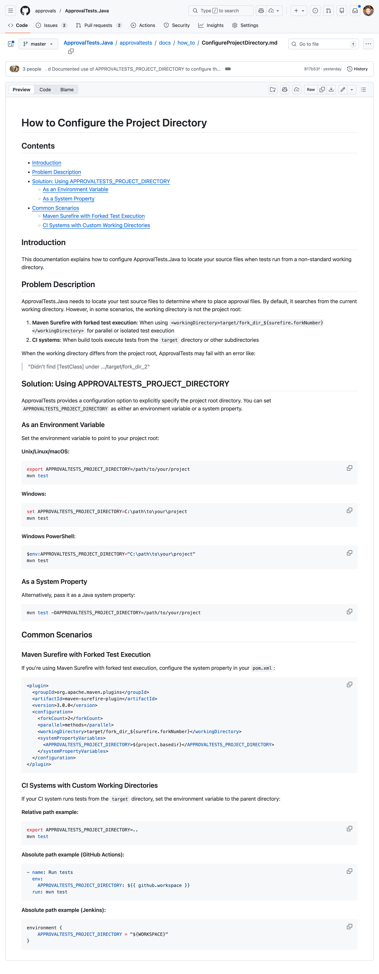

Slide 16


Components
of the AI Prompt
Issue 750
...
+
Documentation
(Markdown)
Impromptu
prompt
Issue 608
Code Base
Please read issue 750 & 608 using the github cli. This is the right solution, but we need to make a howto doc. You can see an example here @ParameterizedTest.md

Slide 17
Dad’s Workout

Slide 18
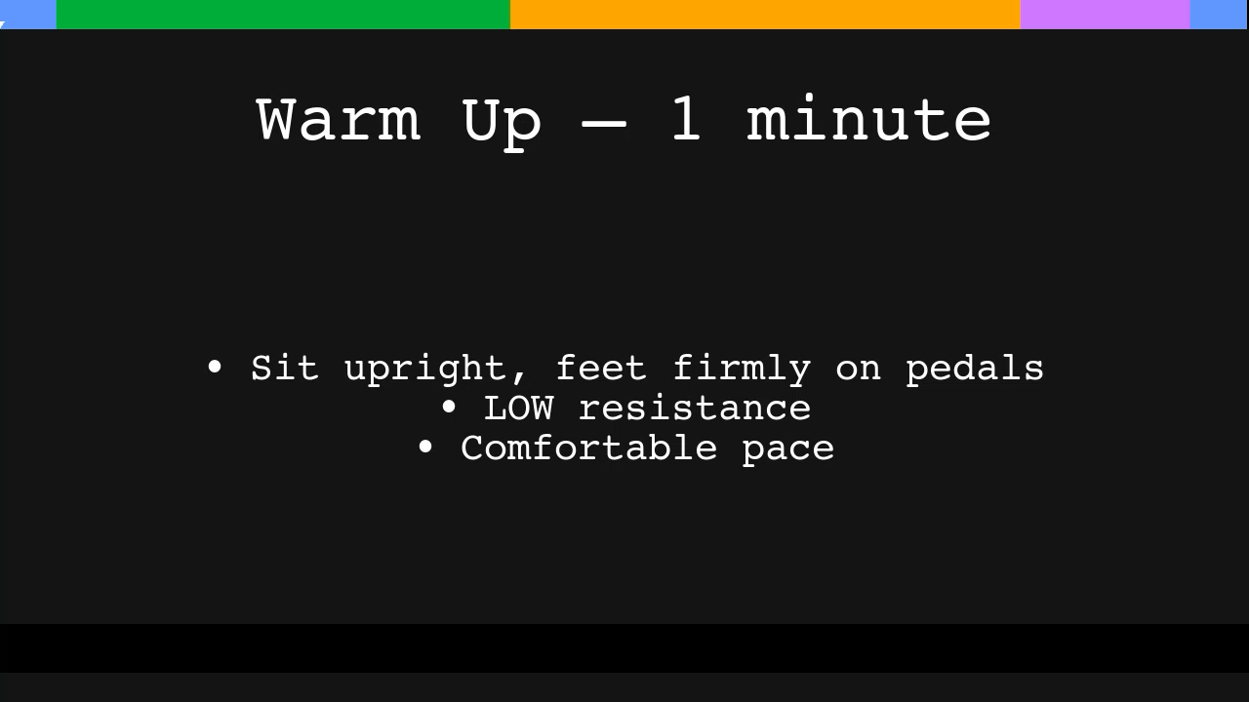

Slide 19

Components
of the AI Prompt
Workout
Video
?

Slide 20
AI Pipeline
?
Workout Plan
(Markdown)

Slide 21
Workout.md
DAILY RECUMBENT BIKE ROUTINE (20 MINUTES)
Focus: Heart Health • Strength • Coordination
Warm up (1 minute)
[ ] Sit upright, feet firmly on pedals
[ ] LOW resistance & comfortable pace
1. STEADY MODERATE RIDE – 8 minutes
Goal: Smooth, steady cardio
[ ] Raise resistance to a moderate level
[ ] Pedal at a steady, comfortable pace
[ ] Breathing should increase, but you can still talk
[ ] Keep shoulders relaxed
[ ] Stay steady for 8 minutes
2. MODERATE INTERVALS – 9 minutes
Pattern:
[ ] 2 minutes easy
[ ] 1 minute moderate
[ ] Repeat again
[ ] Repeat again
3. CADENCE TRAINING – 3 minutes
Goal: Coordination + safe speed work
[ ] Keep resistance LOW
[ ] Maintain an even rhythm
[ ] 20 seconds faster / 40 seconds normal (repeat 3 times)
4. FINISH (1 minute)
[ ] Slow down to an easy coast
[ ] Let heart rate come down
[ ] Take 3–4 deep breaths
[ ] Drink a sip of water
NOTES
Stop if dizzy, light-headed, or unusually short of breath
Slight leg fatigue = normal
Sharp pain = stop immediately
Consistency matters more than speed or intensity

Slide 22
DAILY RECUMBENT BIKE ROUTINE (20 MINUTES)
Focus: Heart Health • Strength • Coordination
Warm up (1 minute)
[ ] Sit upright, feet firmly on pedals
[ ] LOW resistance & comfortable pace
1. STEADY MODERATE RIDE – 8 minutes
Goal: Smooth, steady cardio
[ ] Raise resistance to a moderate level
[ ] Pedal at a steady, comfortable pace
[ ] Breathing should increase, but you can still talk
[ ] Keep shoulders relaxed
[ ] Stay steady for 8 minutes
2. MODERATE INTERVALS – 9 minutes
Pattern:
[ ] 2 minutes easy
[ ] 1 minute moderate
[ ] Repeat again
[ ] Repeat again
3. CADENCE TRAINING – 3 minutes
Goal: Coordination + safe speed work
[ ] Keep resistance LOW
[ ] Maintain an even rhythm
[ ] 20 seconds faster / 40 seconds normal (repeat 3 times)
4. FINISH (1 minute)
[ ] Slow down to an easy coast
[ ] Let heart rate come down
[ ] Take 3–4 deep breaths
[ ] Drink a sip of water
NOTES
Stop if dizzy, light-headed, or unusually short of breath
Slight leg fatigue = normal
Sharp pain = stop immediately
Consistency matters more than speed or intensity
Workout.md

Slide 23

Components
of the AI Prompt
Workout
Video
?
+
Data

Slide 24
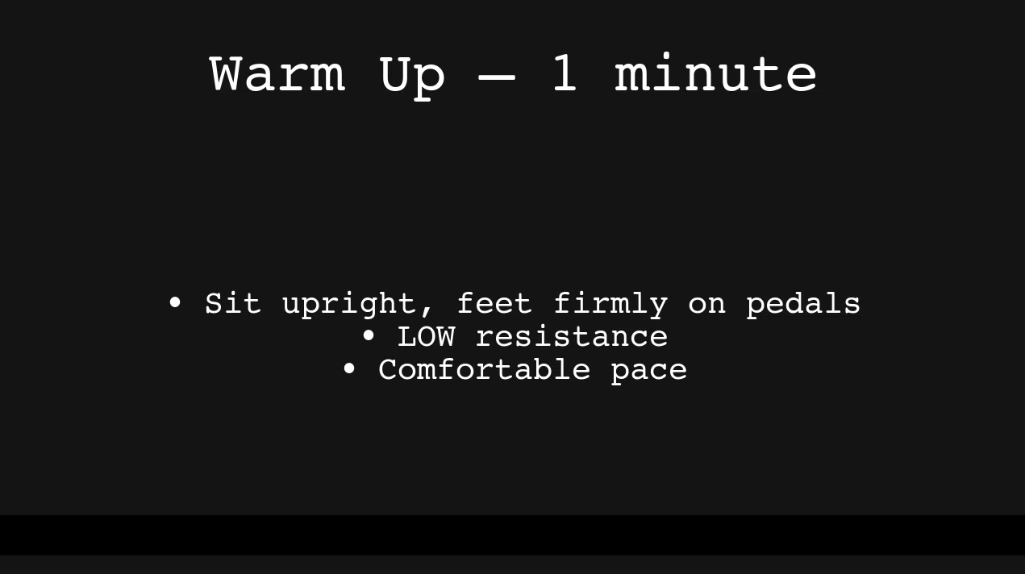
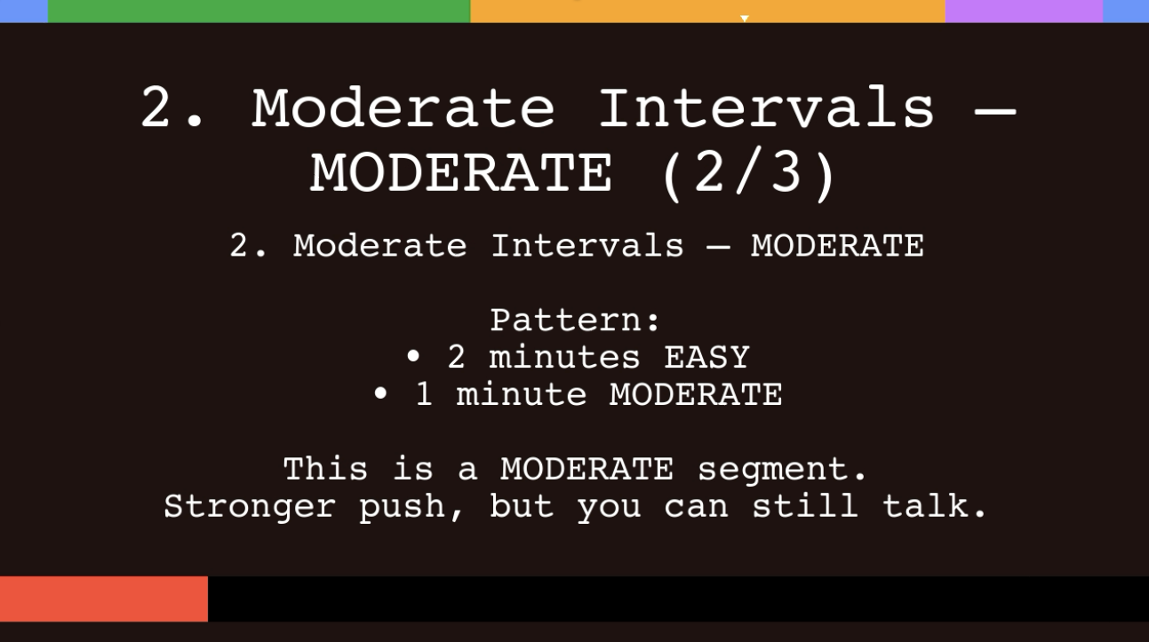
Overall Pointer
Section Bar
45 mins
45 seconds
~3 gb
~3 mb
Red Bar = Hard Movement
Green Bar = Relaxed Movement
Section Timer

Slide 25
AI Pipeline
Workout
Video
?
Workout Plan
(Markdown)
Python

Slide 26
Journal
Interview
Daily
Status
RefineAndClarify
Vomit
1st Pass
Refined
Analysis
VoiceToText.Cleanup
people
Todo
Expericements
Priorize
Super
whisper
Week Points
Say -f
Strong Points
Blog Post

Slide 27

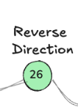
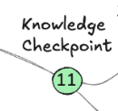
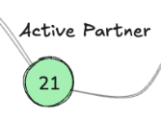
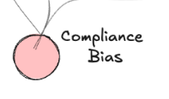
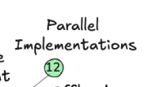
Patterns
Vomit
Interview

Slide 28


Slide 29
Data == Daily Journal

Slide 30
Retreat
Analysis

Slide 31
Building a second brain Collect Organize Distill Extract

Slide 32
Stuck
I have nothing
I have garbage

Slide 33
Vomit

Slide 34
Cleanup
Vomit
1st Draft
Refine & Clarify
“Done is better than perfect”
“Perfect is the enemy of the good”
“The simplest thing that can possibly work”
“YAGNI”

Slide 35
Interview
Vomit
Interview
Collectin 1st Draft
Refined Output

